Slide 1
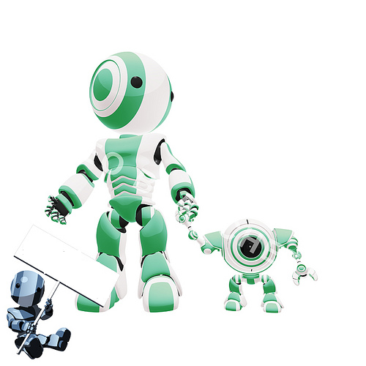

Artificial Intelligence

Slide 2
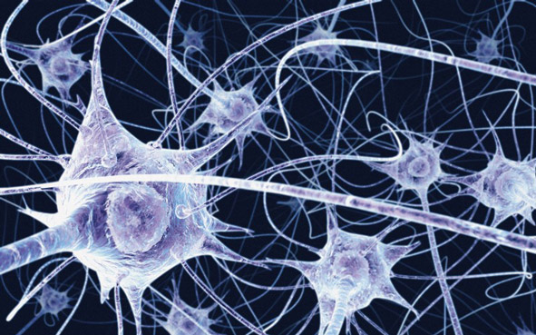
What is Intelligence???
Intelligence is the ability to learn about, to learn from, to understand about, and interact with one’s environment.
Intelligence is the faculty of understanding
Intelligence is not to make no mistakes but quickly to understand how to make them good
(German Poet)

Slide 3
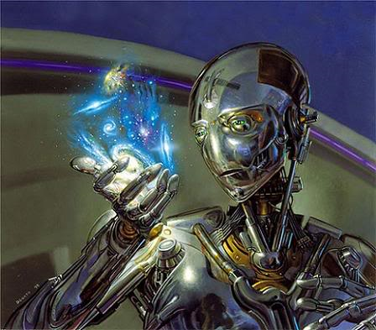
What Is Artificial Intelligence???
Artificial Intelligence (AI) is usually defined as the science of making computers do things that require intelligence when done by humans.
A.I is the study of ideas that enable computers to be intelligent

Slide 4
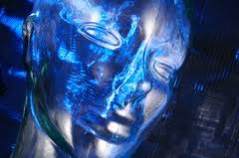
How Does AI Works??
Artificial intelligence works with the help of
Artificial Neurons (Artificial Neural Network)
And
Scientific theorems(If-Then Statements, Logics)

Slide 5
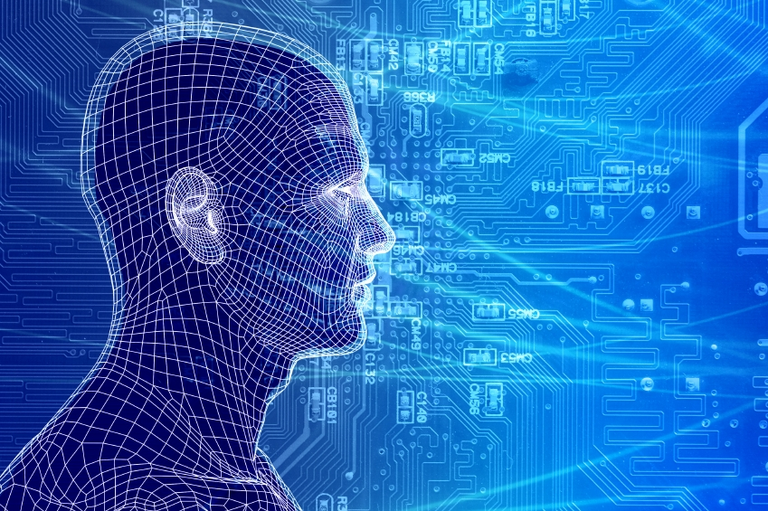
What is Neural Networking??
Artificial neural networks are composed of interconnecting artificial neurons (programming constructs that mimic the properties of biological neurons).

Slide 6


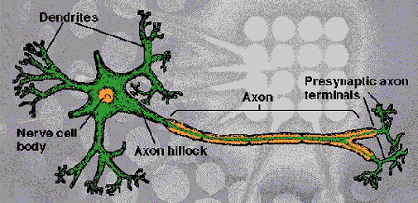
Dendrites: Accepts Inputs
Soma: Processes the Inputs
Axon: Turns the processed inputs into outputs
Synapses: The electrochemical contact between neurons
Sec 2: ANN

Slide 7
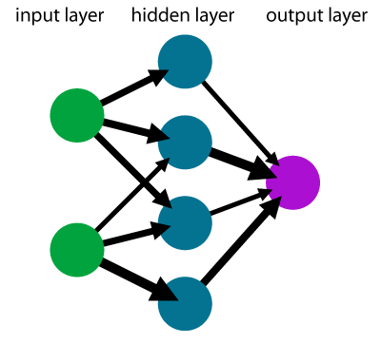
An Artificial Neuron
Axons
Synapses
Dendrites
Body (Soma)
Axon
X₁
W₁
X₂
W₂
X₃
∑
f
W₃
Output (y)
W₀
Xn
W_{n}
Bias
Sec 2: ANN

Slide 8
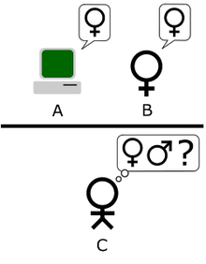
Turing Test
Imitation Game Test!!!!
The Turing test is a test of a machine's ability to demonstrate intelligence

Slide 9
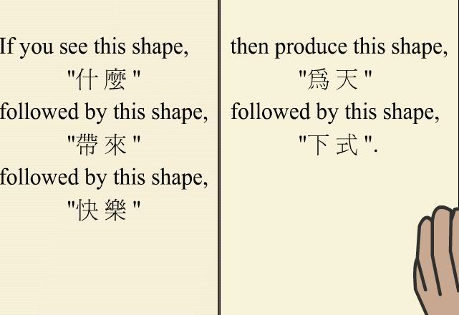
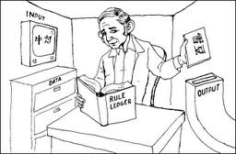
Chinese Room Test
A Counter Argument to Turing Test
Notes:
In this test Searle says to imagine a Man no knowledge of chinese is trapped in a room. He is passed a paper with some chinese writing. He finds a large batch of “Chinese writing” plus “a second batch of Chinese script" and "a set of rules" in English "for correlating the second batch with the first batch. The man follows the instructions and produces a result in chiese language. He himself has no knowledge of the language but gets so good in following instructions that the person standing outside starts to believe that this man is fluent in chinese
What Searle describes is a system that produces intelligent, meaningful output, in the absence of true understanding. If you accept this counter-example, then the Turing Test is doomed. The Chinese Room would pass the Turing test, even though it lacks understanding and intelligence.

Slide 10

Intelligent agents
Agent
Sensors
Actuators
Environment
Percepts
?
Actions

Slide 11

Examples Of Artificial Intelligence
Expert Systems!!
An expert system is a computer program that is designed to hold the accumulated knowledge of one or more domain experts
It reasons with knowledge of some specialist subject with a view to solving problems or giving advice
They are tested by being placed in the same real world problem solving situation

Slide 12


Applications of Expert Systems
PUFF:
Medical system
for diagnosis of respiratory conditions
PROSPECTOR:
Used by geologists to identify sites for drilling or mining

Slide 13
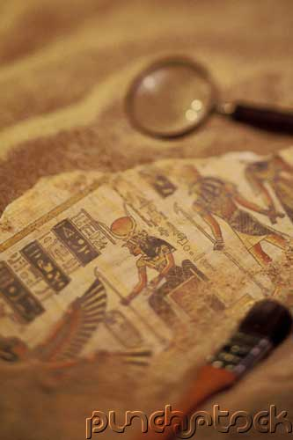
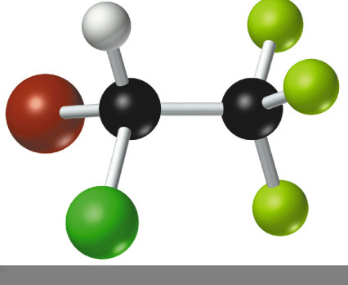
Applications of Expert Systems
DENDRAL: Used to identify the structure of chemical compounds. First used in 1965
LITHIAN: Gives advice to archaeologists examining stone tools

Slide 14
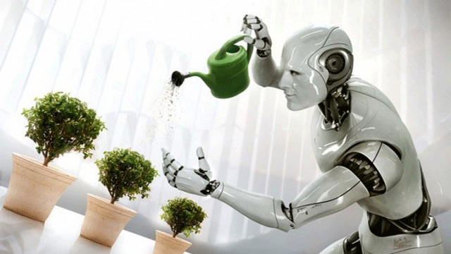
Machine Learning!
Machine learning is a scientific discipline concerned with the design and development of algorithms that allow machines to mimic human intelligence.

Slide 15
There are Three ways that A.I learns
Failure Driven Learning
Learning by being Told
Learning by Exploration

Slide 16
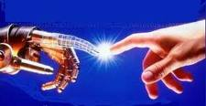
Resemblance To Human Mind....
The special ability of artificial intelligence is to reach a solution based on facts rather than on a preset series of steps—is what most closely resembles the thinking function of the human brain

Slide 17
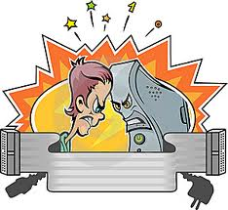
Human Intelligence VS Artificial Intelligence

Slide 18
Human Intelligence VS Artificial Intelligence
Pros
Human Intelligence
Artificial Intelligence
Intuition, Common sense, Judgement, Creativity, Beliefs etc
The ability to demonstrate their intelligence by communicating effectively
Plausible Reasoning and Critical thinking
Ability to simulate human behavior and cognitive processes
Capture and preserve human expertise
Fast Response. The ability to comprehend large amounts of data quickly.
Notes:
The important aspects of human intelligence seem to following the use of intuition, common sense, judgment, creativity, goal directedness, plausible reasoning, knowledge and beliefs.
Meaning of intelligence is not human brain’s information processing ability but the ability of humans to demonstrate their intelligence by communicating effectively.

Slide 19
Human Intelligence VS Artificial Intelligence
Cons
Human Intelligence
Artificial Intelligence
  Humans are fallible
  They have limited knowledge bases
  Information processing of serial nature proceed very slowly in the brain as compared to computers
Humans are unable to retain large amounts of data in memory.
No “common sense”
Cannot readily deal with “mixed” knowledge
May have high development costs
Raise legal and ethical concerns

Slide 20
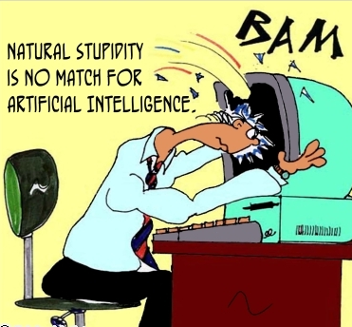
Human Intelligence VS Artificial Intelligence
We achieve more than we know. We know more than we understand. We understand more than we can explain (Claude Bernard, 19th C French scientific philosopher)

Slide 21
Artificial Intelligence VS Conventional Computing
Artificial Intelligence
Conventional Computing
AI software uses the techniques of search and pattern matching
Programmers design AI software to give the computer only the problem, not the steps necessary to solve it
Conventional computer software follow a logical series of steps to reach a conclusion
Computer programmers originally designed software that accomplished tasks by completing algorithms

Slide 22
Psychology And Artificial intelligence
The functionalist approach of AI views the mind as a representational system and psychology as the study of the various computational processes whereby mental representations are constructed, organized, and interpreted.
(Margaret Boden's essays written between 1982 and 1988)

Slide 23
Artificial intelligence & Our society
Why we need AI??
To supplement natural intelligence for e.g we are building intelligence in an object so that it can do what we want it to do, as for example-- robots, thus reducing human labour and reducing human mistakes

Slide 24
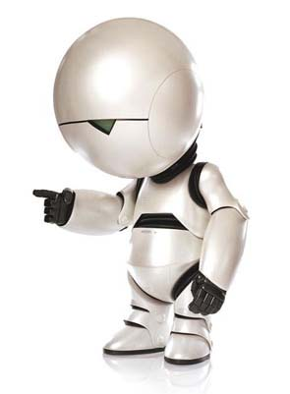
My Perspective
For Humans Intelligence is no more than TAKING a right decision at right time
And
For Machines Artificial Intelligence is no more than CHOOSING a right decision at right time
I think Artificial intelligence is the Second intelligence ever to exist

Slide 25



Go Ahead With Question
Be Not Afraid Of Falling Be Afraid Of Not Trying

Slide 26


Artificial Intelligence
Our Attempt To Build Models Of Ourselves
Thank You
Elaine Rich

